Slide 1
Computer science III final project: Homework Survey Client
By: Sarah Walker

Slide 2
Intro
Past homework survey as inspiration
Collect data from user
Show graph of day and month
Learn jFreeChart
Integrate with day class
Client
Learn to use the API, program for user (and what to expand on)

Slide 3
Process
Java
jFreeChart API

Slide 4
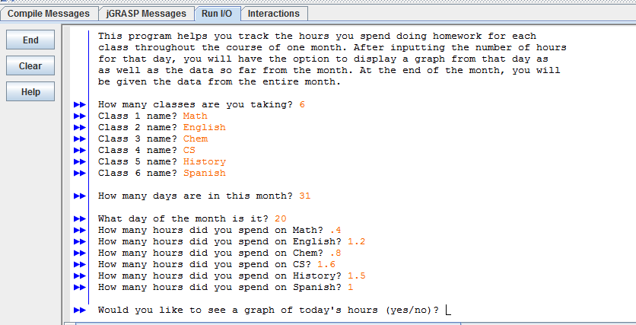
Demo
Client 1: User-based

Slide 5
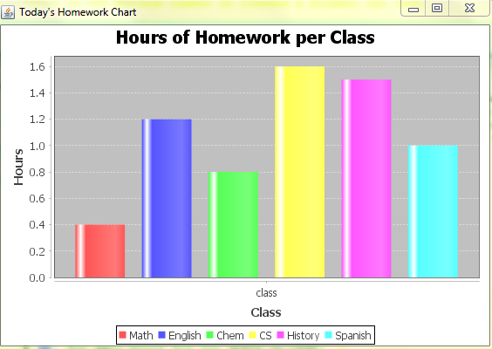
DEMO
Client 1: User-based

Slide 6
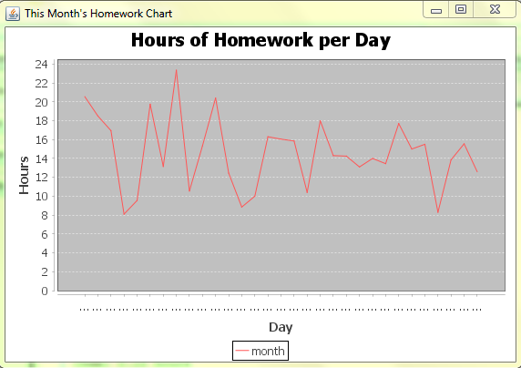
Demo
Client 2: File-based

Slide 7
Results
Created 2 clients
Showed both types of graphs
Difficult to balance input types, learn graphs

Slide 8
Future work
Integrate two clients
Figure out a way to ask user for data once a day and store that data in a text file

Slide 9
For more information
www.tutorialspoint.com/jfreechart/jfreechart_bar_chart.htm

